Slide 1
BLACK LEG
By
Dr. Hussein Al Naji

Slide 2
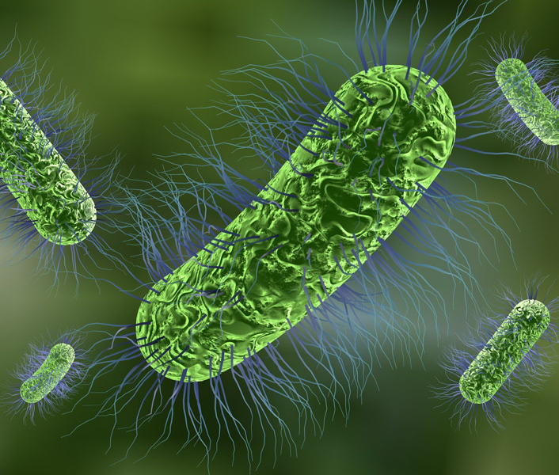
ETIOLOGY
This Photo by Unknown Author is licensed under CC BY-NC-ND
Blackleg, or clostridial myositis of skeletal and/or heart muscle tissue, is associated with Clostridium chauvoei (feseri), a gram positive, spore-forming, rod-shaped bacterium. The spores are normally found in soil.
Blackleg is an acute febrile disease primarily affecting cattle and sheep, with worldwide occurrence.

Slide 3
Transmission
In cattle the disease usually occurs without a history of trauma
In sheep, skin wounds from shearing, docking, fighting and vulvar or vaginal lacerations from parturition or the fresh navel at birth are the most common routes through which C. chauvoei penetrates and infects muscle tissue to cause clinical disease.
Occasional out breaks have occurred in sheep after vaccination against enterotoxemia.

Slide 4
Pathogenesis
Spores of C. chauvoei have been found normally in the soil, digestive tract, spleen and liver healthy animals
In sheep the disease related to tissue laceration and trauma, the stimulus growth of the latent bacterial spores but in cattle is unknown.
C. chauvoei produces a number of toxins, such as
1- oxygen-stable
2-oxygen-labile
3-hemolysins,DNase,
4-hyaluronidase,
5-neuramidase,.
cause severe necrotizing myositis locally in skeletal muscles and a systemic toxemia that is usually fatal.

Slide 5
CLINICAL FINDING
In cattle
In the early stages, the swelling is hot and painful to the touch but soon becomes cold and painless, and edema and emphysema can be felt.
The skin is discolored and soon becomes dry and cracked.
The animal will be found to be very depressed, have complete anorexia and ruminal stasis, and have a high temperature (41° C).
The animal is observed before death there is severe lameness, usually with pronounced swelling of the upper part of the affected leg.

Slide 6
CLINICAL FINDING
In Sheep
A stiff gait, and the sheep is disinclined to move because of severe lameness in one limb or, more commonly, in several limbs. The lameness may be severe enough to prevent walking.

Slide 7
Clinical pathology
Culture from needle biopsy.
No diagnostic change in hematology or serum biochemistry.
Necropsy findings
Myositis; dark, rancid odor, metallic sheen on the cut surface.
Diagnostic confirmation
Fluorescent antibody identification of C. chauvoei in lesion.
PCR

Slide 8
DIFFERENTIAL DIAGNOSIS 1- Malignant edema 2- Anthrax 3- Lightning strike 4- Bacillary hemoglobinuria 4- Other causes of sudden unexpected death
TREATMENT AND CONTROL
Treatment Penicillin G sodium/potassium (44,000 IU/kg IV q6–8h).
Clostridium chauvoei antitoxin (only in early stages, but doubtful efficacy)
Control
1- Multivalent clostridial vaccine including at least C. chauvoei, C. septicum, and C. novyi (R-2)
2- Penicillin (44,000 IU/kg IM q24 for 3 days for animals at risk) (R-2)

Slide 9
Thank you

